Slide 1
Name : K.MOHAMED SHAFIQ
NM.ID : au730321104025
RegNo : 730321104025
Dept : B.E-CSE
Year : 3rd-year
College : Builders Engineering College

Slide 2
IPL SCORE PREDICTOR
An IPL score predictor is a tool or system designed to forecast or predict the scores of matches in the Indian Premier League (IPL) cricket tournament. It utilizes various data such as historical match data, team performance, player statistics, match conditions (like venue and weather), and other relevant factors to generate predictions about the runs a team is likely to score in a given match or innings.

Slide 3


AGENDA
Project Planning and Research
Data Collection and Preprocessing
Feature Engineering
Model Selection and Development
Model Evaluation and Optimization
Testing and Validation
Deployment and Maintenance
3/21/2024 Annual Review

Slide 4

PROBLEM STATEMENT
This problem statement outlines the goals, tasks, and expected outcomes of developing an IPL score predictor using deep learning, emphasizing the use of LSTM networks and data-driven approaches for accurate match score predictions.
Key Challenges
Data Quality and Availability:
Feature Engineering:
Model Complexity and Training:
Prediction Accuracy and Robustness:
Data Drift and Seasonal Variations:
User Interface and Deployment:

Slide 5

PROJECT OVERVIEW
The IPL Score Predictor is an AI-driven system designed to forecast the runs scored by cricket teams in Indian Premier League (IPL) matches. Leveraging deep learning techniques, specifically Long Short-Term Memory (LSTM) networks, the predictor aims to provide accurate predictions based on historical match data, team statistics, player performances, match conditions, and other relevant factors.
Objectives:
The objective of this project is to develop an IPL score predictor using deep learning techniques, specifically LSTM networks, to forecast the runs scored by cricket teams in IPL matches. The predictor aims to provide accurate and reliable predictions based on historical match data, team statistics, player performances, match conditions, and other relevant factors.

Slide 6

WHO ARE THE END USERS?
The end users of the Next Word Predictor can vary across different contexts and applications. Here are some examples of potential end users:
Cricket Enthusiasts and Fans
Analysts and Statisticians
Sports Media and Broadcasters
Sports Betting Platforms and Gamblers
Coaches and Team Management
Cricket Journalists and Content Creators

Slide 7
SOLUTION AND ITS VALUE PROPOSITION
the IPL Score Predictor serves as a valuable tool for various stakeholders in the cricket ecosystem, empowering them with data-driven insights, predictions, and analysis to enrich their IPL experience, decision-making processes, and engagement with the sport.
Key components:
1. Data Collection and Preprocessing
2. Feature Engineering
3. Model Evaluation and Validation
Value Proposition:
Accurate Predictions
Data-Driven Insights
Enhanced Decision Making
Improved Content Creation

Slide 8

THE WOW FACTORS:
Accuracy and Precision: The predictor's ability to generate highly accurate predictions of IPL match scores based on deep learning techniques and comprehensive historical data sets it apart. Users are impressed by the precision of predictions, which enhances their trust and confidence in the predictor.
Real-Time Updates: Providing real-time updates and predictions during live IPL matches is a "wow" factor that keeps users engaged and excited. The ability to deliver timely insights and predictions adds value and relevance to the user experience.
Interactive Visualization: Incorporating interactive visualizations such as charts, graphs, and match simulations enhances the user interface and makes the predictor more engaging and intuitive. Users appreciate the visual representation of data and predictions.
Customization and Personalization: Offering customization options for users to tailor predictions based on specific criteria or preferences adds a personalized touch. This customization feature makes the predictor more adaptable and user-friendly.
Advanced Analytics: Incorporating advanced analytics capabilities such as trend analysis, player performance metrics, and match dynamics insights impresses users who seek in-depth analysis and insights beyond basic predictions.
3/21/20

Slide 9
MODELLING
Models:
Linear Regression Model:
Random Forest Regression Model:
Gradient Boosting Regression Model:
Training:
Gather historical IPL match data including team details, venues, toss winners, innings scores, and outcomes.
Create informative features such as average runs per innings, run rate, team form indicators, player performance metrics, and match conditions.
Advanced Techniques:
Anomaly Detection and Error Analysis:
Description: Incorporate anomaly detection algorithms to identify unusual patterns or outliers in IPL match data, which may impact prediction accuracy.
Benefits: Enhances model robustness, identifies data quality issues, and facilitates error analysis for model improvement and debugging.

Slide 10
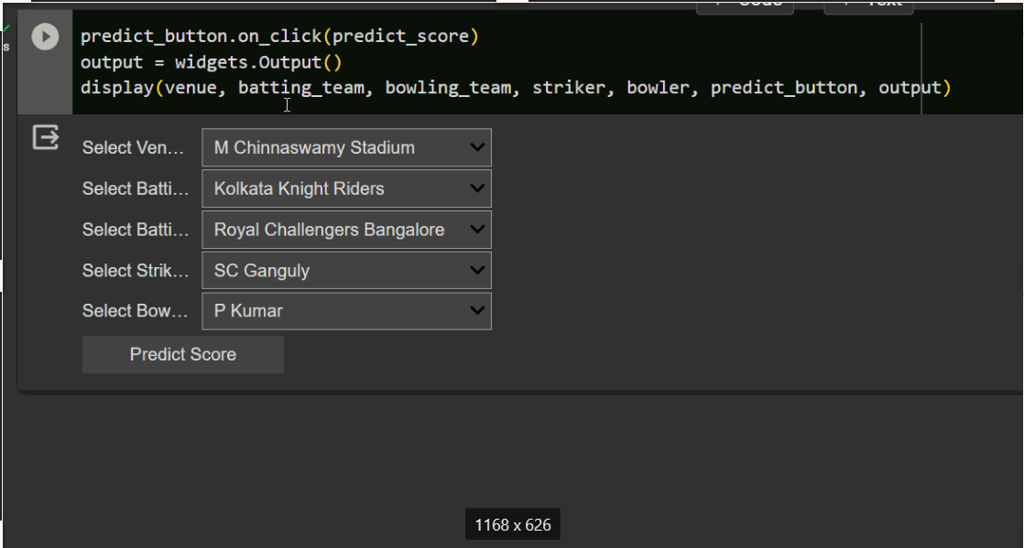
RESULTS

